Slide 1
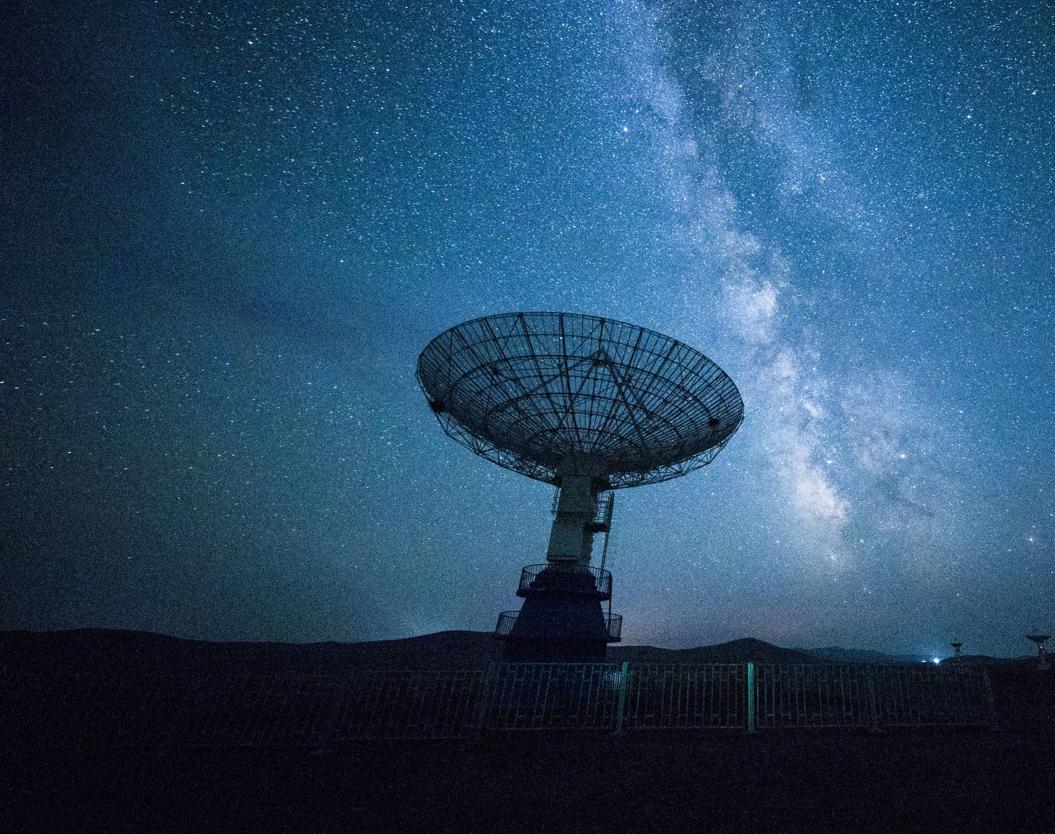
APPLICATIONS OF RADAR

Slide 2
Guide
Prof.Shilpa Lambor
Group Members
Shaunak Deshpande (04)
Gaurav Shejwal (05)
Shrawani Shinde (09)
Shivang Singh (12)

Slide 3
What is RADAR?
The word RADAR is an acronym for RAdio Detection and Ranging.
RADAR a system for detecting the presence, direction, distance, and speed of aircraft, ships, and other objects, by sending out pulses of radio waves which are reflected off the object back to the source.
RADAR transmits radio signals at distant objects and analyses the reflections.

Slide 4
Operating principle
1. The radar is transmitting an electromagnetic pulse.
2. The radar switches to listening mode.
3. The pulse is reflected by a target.
4. The radar receives the echoes from the transmitted pulse.

Slide 5
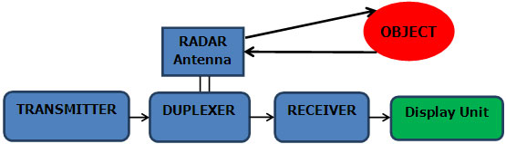
Block diagram of modern radar system

Slide 6
Applications of RADAR - an overview
Radars are very much used in defense weapons systems and in safety and navigation applications.
Search radars are used to locate enemy missiles and planes to acquire a target.
Radars are widely used on planes and ships for navigating blind in fog or bad weather.
Radars help ground controllers to locate and identify nearby planes.

Slide 7
Applications of RADAR - an overview
Special radars assist planes in landing in bad weather when visibility is near zero.
Radars are used as altimeters to measure height.
Special terrain following radars allows high speed jets to fly very close to the ground to avoid detection by enemy radar.

Slide 8

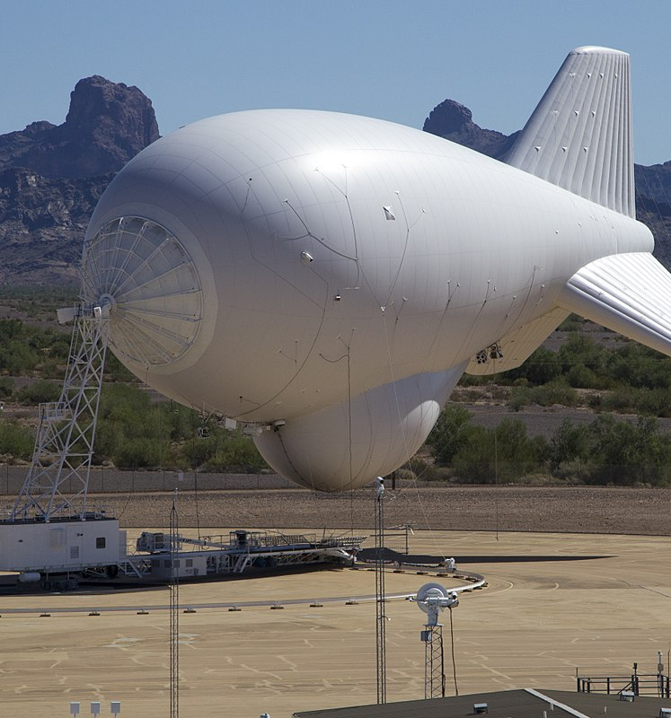
Marine RADAR
A marine radar device acts as a major navigation aid for boaters. It helps in detecting boats, birds, landmasses, and weather systems - even if the visibility is less than usual.
The marine radar works on the basic principle of electromagnetic waves. The radar antenna sends the high-speed electromagnetic waves to establish the location, which is the distance, the velocity and the direction the wave travelled along with the altitude of the object, moving or stationary.
Electromagnetic energy travels through air at a high constant speed, equivalent to the speed of light (300,000 kilometres per second).
This Photo by Unknown author is licensed under CC BY-SA.

Slide 9
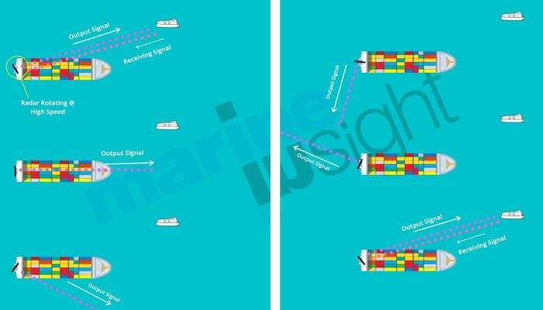
Marine RADAR

Slide 10
Marine RADAR
The two fundamental features of a marine radar unit are transmitter power and beam angle.
Power can range between 2-4 Kilowatts. Power is a crucial factor in defining how well your radar performs in bad weather. The higher the power of a radar, the better your transmitter can see through dense fog and rain, and the further the signal can reach.
Beam angle is determined by the size of a radar antenna. A long antenna emits a narrower beam that can discriminate better between objects that are close together than a shorter antenna.

Slide 11
Marine RADAR
Uses of Marine RADAR:
To calculate range and bearing of a target and thereafter use the information to determine speed, course etc.
Navigating own vessel and her course with regard to collision avoidance
Fixing the ship’s position using terrestrial objects such as lighthouses, buoys etc.

Slide 12

SAR (Synthetic Aperture Radar)
A satellite-based synthetic aperture radar (Synthetic Aperture Radar, SAR) scans the earth's surface by means of microwave radiation.
The SAR antenna transmits microwave pulses and receives the backscattered echo from the surface. Based on this echoes high resolution image data and data products can be produced.
It is possible to observe the Earth's surface even on cloudy days and at night. On the other hand physical variables such as the backscattering coefficient or path length differences in the viewing direction of the SAR antenna can be derived.

Slide 13
SAR (Synthetic Aperture Radar)
The backscattering coefficient depends on the physical properties of the observed surfaces. The main properties are surface roughness, geometry and dielectric properties, primarily affected by surface moisture.
Another important feature of radar remote sensing is the penetration depth, respectively the penetration of loose sediments and vegetation in relation to the used wavelength.
For geoscientific remote sensing the measurement of surface roughness is an important parameter and therefore it is used together with optical remote sensing techniques for geologic mapping. The capability to penetrate through loose sediments is an important parameter for mapping tectonic structures. The capability to penetrate through vegetation is an important characteristic for geologic and tectonic mapping. Object recognition based on radar data is of particular significance for geoscientific applications in regions with frequent cloud coverage.

Slide 14
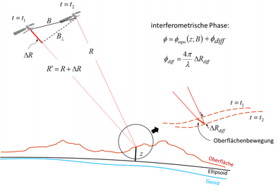
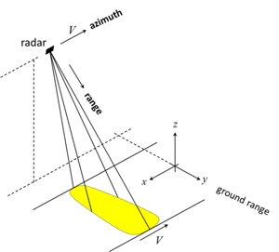
SAR (Synthetic Aperture Radar)

Slide 15

SMR(Surface Movement Radar)
Surface Movement Radar (SMR) is radar equipment specifically designed to detect all principal features on the surface of an airport, including aircraft and vehicular traffic, and to present the entire image on a radar indicator console in the control tower. Used to augment visual observation by tower personnel of aircraft and/or vehicular movements on runways and taxi-ways.

Slide 16
Role of SMR
In the permanent absence of visual observation of all or part of the maneuvering area or to supplement (or in poor visibility, replace) visual observation, SMR may be utilized to:
enhance the controllers' situational awareness regarding the maneuvering area;
monitor the movement of aircraft and vehicles on the maneuvering area;
provide routing information to pilots and vehicle drivers as necessary; and
provide advice and assistance for the safe and efficient movement of aircraft and vehicles on the maneuvering area.
In order to operationally use SMR the tower controllers need to obtain an additional endorsement GMS (ground movement surveillance) to their ADI rating.

Slide 17
Technical Specifics of SMR
The SMR uses the working principle of the Primary Surveillance Radar (PSR), i.e. emits a signal which is reflected by the target and the echo received is used to determine the range and bearing of the target.
The SMR however, operates on much higher frequencies (10-20 GHz) as opposed to the PSR (1-5 GHz). As a result, the antenna is much smaller (and lighter) which allows faster rotation (typically 1 revolution per second as opposed to 6-12 revolutions per minute) and therefore faster update rate. While range is considerably shorter compared to other radars (not to be considered to be a drawback though since the very purpose of the SMR is to cover only the maneuvering area) this allows for shorter pulse to be used which in turn results in much better range resolution (about 20 m).

Slide 18
Technical Specifics of SMR
The SMR is often mounted on top of the ATC tower which provides good visibility of the manoeuvring area.

Slide 19
Project NISAR
NISAR -> NASA-IISRO Synthetic Aperture RADAR
This is the only satellite that will include S-Band and L-Band RADAR
S-Band -> IISRO Completed the development.
L-Band -> NASA will complete the development.
2). This is world's most expensive earth-observing satellite project.
Total-> $920 million
India -> $110 million
NASA -> $808 million
Capable of measuring changes in earth's surface for less than centimeter across.
NISAR will help to measure the surface deformities like earthquakes, volcanic eruption, etc.
Will be launched by January 2023 by IISRO using GSLV.

Slide 20
Advantages
The radar can see through the medium consisting of fog, snow, rain, darkness, clouds etc.
Radar signal can penetrate and see-through insulators.
It can help find out following parameters of object or target: 1. Range 2. Angular Position 3. Location of Target 4.Velocity of Target
It can distinguish fixed as well as moving target type.

Slide 21
Future Scope
With rising advancements in stealth technology there must always be a way to counter it and that’s possible only by radars.
If a country is developing a stealth technology that reduces a fighter jet’s RCS (Radar Cross-Section), then other countries must develop a technology to detect the plane with lower RCS in order to protect themselves from threat posed by the plane.
A new emerging field in radar technology is the quantum radar technology, which uses the principles of quantum entanglement. A quantum radar can be made to even find planes and other object with very good stealth features.

Slide 22
References
https://www.oceanoculus.com/news-from-the-sea/everything-you-need-to-know-about-marine-radars
https://www.bgr.bund.de/EN/Themen/GG_Fernerkundung/Radarfernerkundung/radarfernerkundung_node_en.html
https://www.marineinsight.com/marine-navigation/marine-radars-and-their-use-in-the-shipping-industry/#:~:text=The%20marine%20radar%20works%20on,the%20object%2C%20moving%20or%20stationary.
https://www.skybrary.aero/index.php/Surface_Movement_Radar

Slide 23
THANK YOU.

